Slide 1
Sprint 7
Retro
Group 104

Slide 2
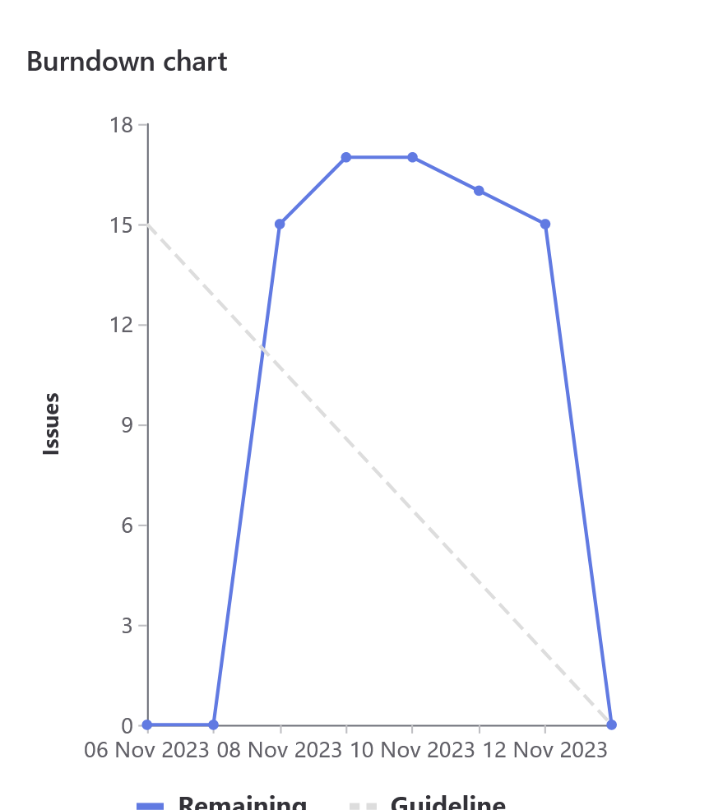
Burn Down Chart
Total Issues Weight: 104

Slide 3
How Did It Go?
+
+
+
-
-
Addressed all tasks listed in the assignment handout
Excellent Communication
Learned alot about Web Development
Starting on weekend
Conflicting workflows

Slide 4
01
OVERVIEW

Slide 5
Dawoud (Weight:20)
Team Lead Tasks
Updated Filtering UI
Updated FrontEnd to use our API

Slide 6
Riley (Weight:20)
1
2
3

Slide 7
Eason
(Weight:20)
1
2
3

Slide 8
Thomas
(Weight:22)
1
2
3

Slide 9
Hasen
(Weight:20)
Initialized the CI/CD Pipeline
Monitored the pipeline for any deployment discrepancies
Assisted Thomas with our homepage responsiveness and refactoring

Slide 10
John
(Weight:20)
1
2
3

Slide 11
Karanvir
(Weight:28)
Worked on a proposal for increasing the efficiency of the “getPossibleCourses” API.
Worked with John to implement the “getPossibleCourses” API.
Cleaned up and refactored our file structure for better organization.
Refactored our “loadcourses” API to use a more elegant solution.

Slide 12

Demo

Slide 13
THANKS!
Please, keep this slide for attribution.

